Slide 1

SREENIDHI INSTITUTE OF SCIENCE AND TECHNOLOGY DEPARTMENT OF COMPUTER SCIENCE & ENGINEERING
GROUP PROJECT- Final ppt
PROJECT TITLE
BATCH N0.- 19-GP-A19
19311A0503 KALLA GOUTHAM
19331A0539 N.SIDDHARTHA REDDY
19861A0557 C.PREM SAI
INTERNAL GUIDE:
Dr.H.Balaji

Slide 2
CARTOONING AN IMAGE​
Internal Guide:
Dr.H.Balaji
Project Coordinator:
Dr.R.LAKSHMI PRIYA
PRESENTED BY:19311A0503
19331A0539
19861A0557

Slide 3
Contents:
• Abstract
• Introduction
• Existing system
• Proposed System
• Requirements
• Conclusion
• References

Slide 4
Abstract:
Before we need a skilled person to draw or convert an image into animated sketch or image. Later after the development in technology one needed high graphical based software to trace an image feature and shape the edges properly and add some extra features for being specific where a lot of knowledge or skill is needed even using technology also. As the technology is developing more and more day-to-day image processing came into existence which helped people or made the work easier for converting the image where image processing can be implemented using python along with the help of some libraries like open cv. OpenCV is a cross-platform library using which we can develop real-time computer vision applications. It mainly focuses on image processing, video capture and analysis including features like face detection and object detection

Slide 5
Introduction:
Web-based media is widely utilized nowadays. What’s more, hanging out in this online group has consistently been a to-do on each client been a to-do on each client’s rundown on these web-based media stages. Be it pictures, blog entries, work of art, tweets, images, conclusion and what not being utilized to look for consideration of supporters or companion to make impact or to interface with them on such friendly stages. We mean to give one such clever fix to their necessities, which is applying animation like impact to their picture. Client can later share these pictures on any friendly media stages, save it for themselves, share with family and do whatever they like with it. You can use utilize your very own profile picture, make an interesting symbol or transform your photograph into an animation with a pool of web application accessible on the web

Slide 6
Existing system:
The existing system of the cartoonifying an image using open cv libraries in python is efficient to an extent. It makes easier to visualize and draw the picture if it is cartoonified but in existing system there are many flaws and some problems in this technology.
The following are the drawbacks of the existing System:
• Less resemblance of cartoon to original.
• No accuracy in detecting edges.
• Less Features (filters , size of filters , libraries to get exact view)

Slide 7
Proposed System:
In addition to the existing system of the Technology we are including the libraries of easygui and the new CV library cv2 in order to get the technology that can detect the edges accurately and apply the more number of bilateral filters and apply more colors to the cartoon we obtain and this proposed technology enables us to resize the given image which enables us to use them for multiple purposes.
Basically, we are going to use a series of filters and image conversions.
First we downscale the image and then apply bilateral filter to get a cartoon flavor. Then again we upscale the image.
Next step is getting a blurred version of the original image. Now, we don’t want the colours to interfere in this process. We only want the blurring of the boundaries. For this, we first convert the image to gray – scale and then we apply the media blur filter.
Next step is to identify the edges in the image and then add this to the previously modified images to get a sketch pen effect. For this first we are using adaptive threshold. You can experiment with other types of threshold techniques also. Because Computer Vision is all about experimenting. In step 5, we compile the final images obtained from the previous steps.

Slide 8
Proposed System:
MERITS-
More filters
More number of filter sizes
More number of colours
Technology that can detect edges more accurately
Resizing Tools
Using Adoptive Thresholds

Slide 9
Objective of the project
Making an animation like impact is existence devouring. Existing answers for give animation like impact to picture are mind boggling. A few arrangements include introducing complex photograph altering programming like photoshop and other include playing out some assignment by client. Our exploration shows a site to complete to undertaking of applying impacts is more appropriate, space effective and takes least client endeavors, for model toony photograph is a current site to perform such task yet it is hard to use a client needs to markdown focuses and line on the picture to apply impacts which isn’t client additionally the choices are restricted.

Slide 10
Requirements:
Software Requirements:
Language & Technology : Python, Open CV library,NumPy
IDE : Python IDE.
Operating System : Windows XP and above.
Hardware Requirements:
Processor : Intel i3 processor
RAM : Min. 4GB
Hard Disk : 20GB

Slide 11
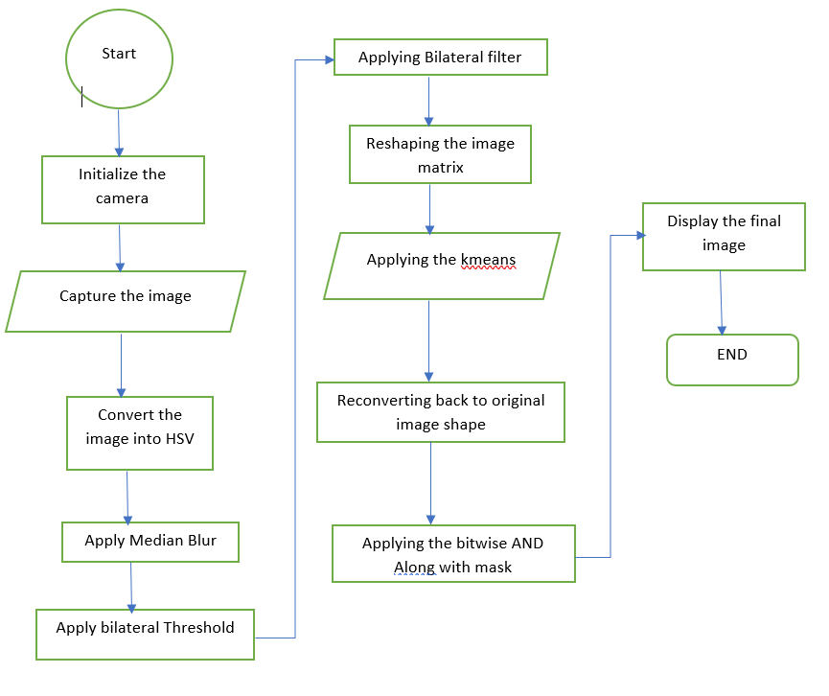
Architecture Design

Slide 12
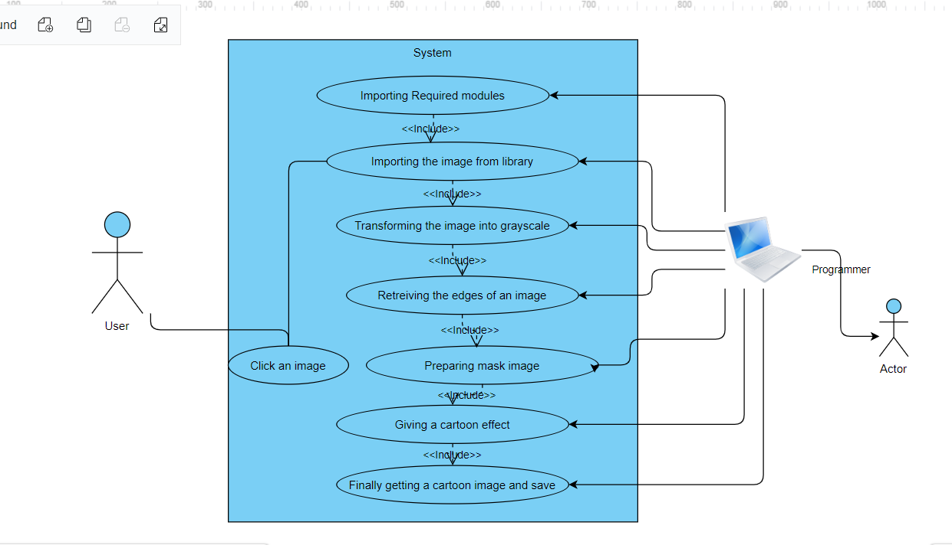

Slide 13
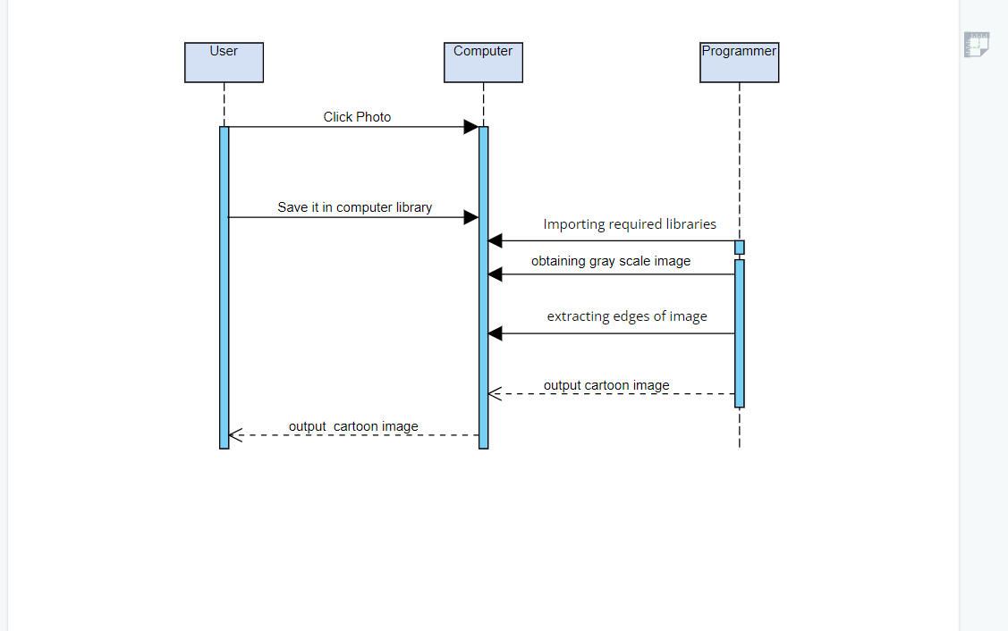

Slide 14
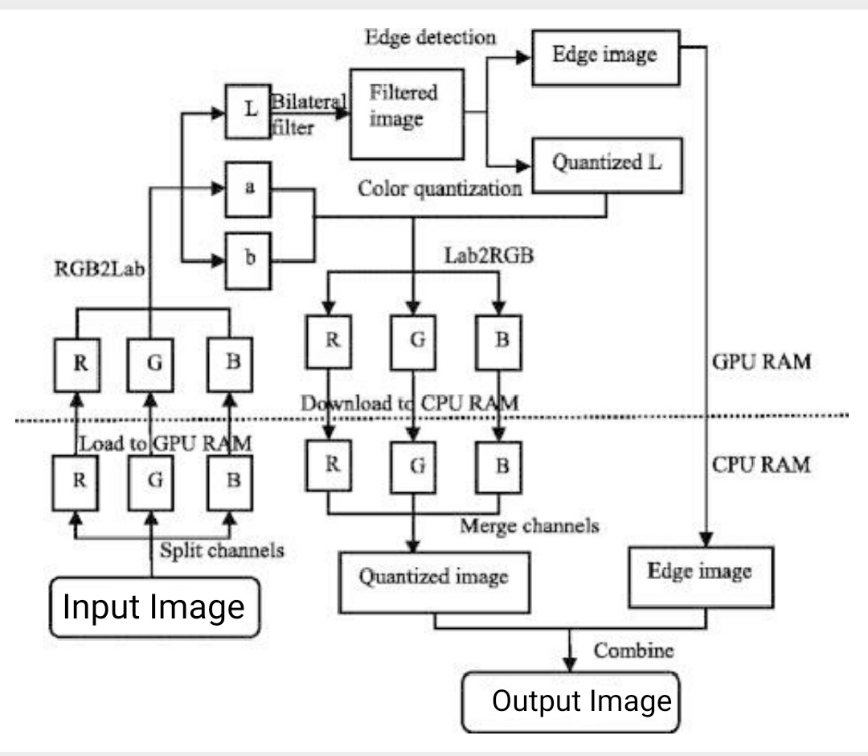

Slide 15
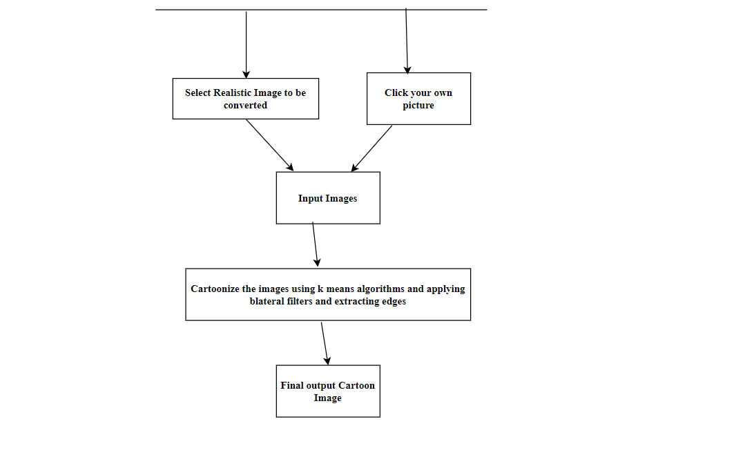

Slide 16
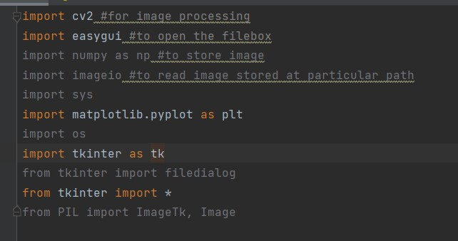
Code:

Slide 17
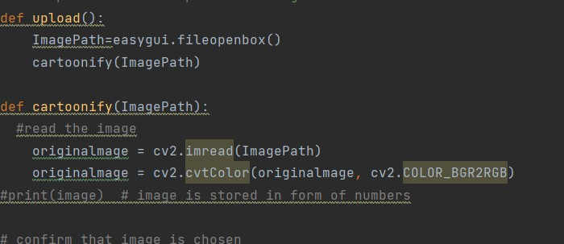

Slide 18
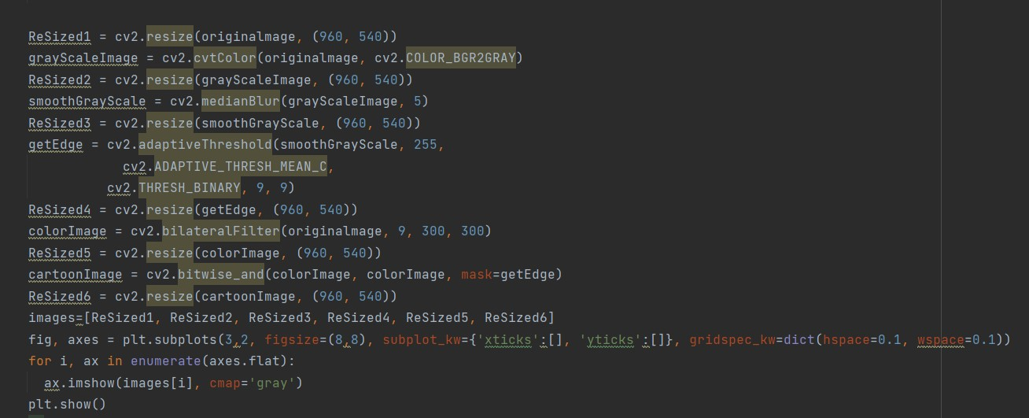

Slide 19
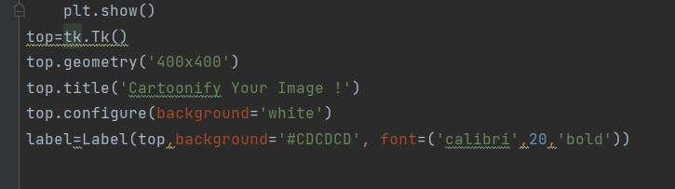

Slide 20
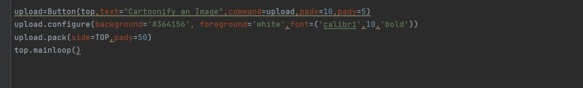

Slide 21
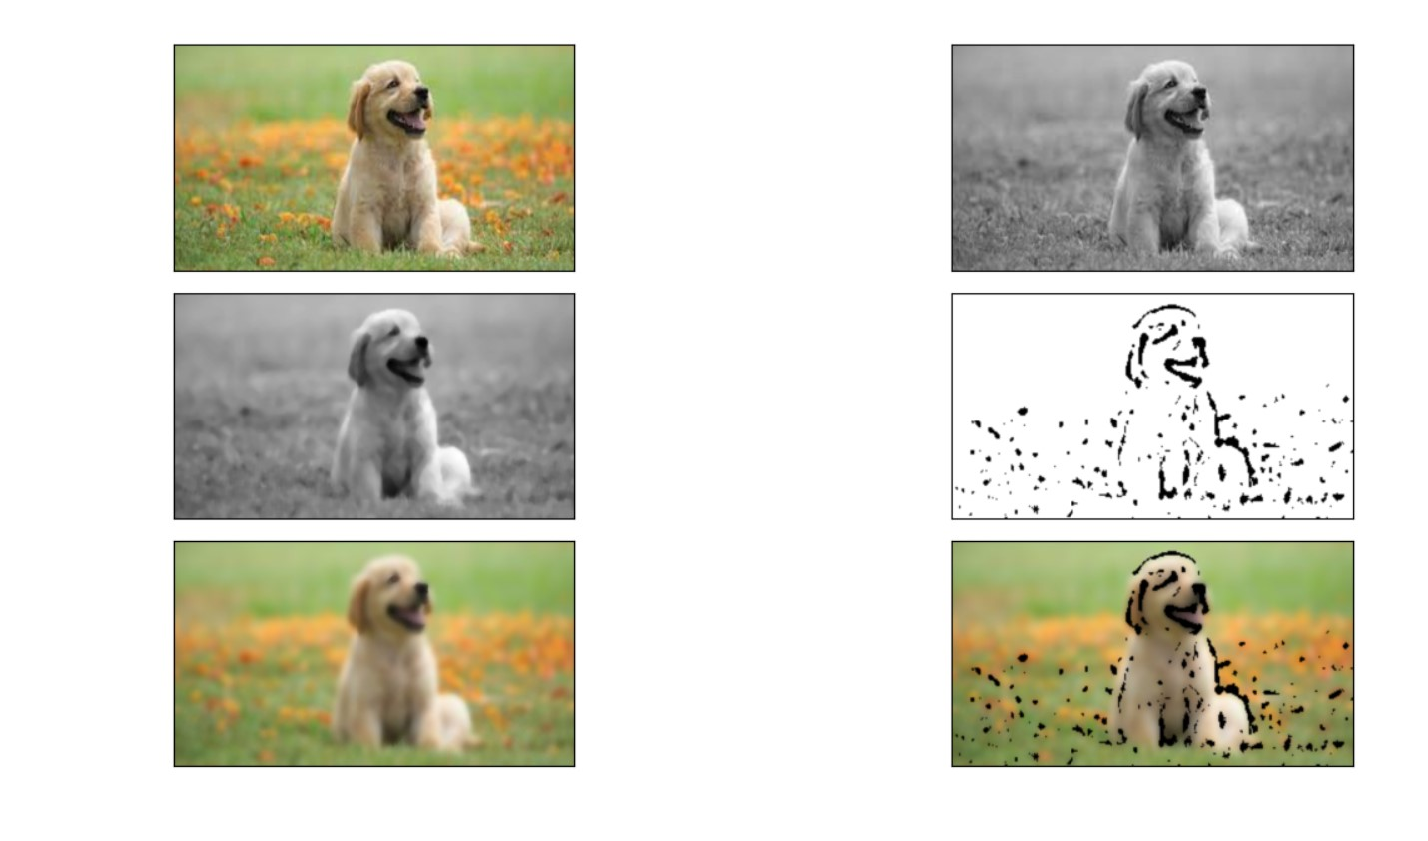
Output:

Slide 22
Conclusion:
Firstly, we use camera and then we capture a image, Secondly we use image processing using open cv library and python, Third the captured image is converted from BGR to HSV where Median blur, Adaptive and bilateral along with K-means clustering is applied on the captured image and the final processed image with cartoon effect is obtained

Slide 23
References:
➢ Jayesh Gangrade1, Surinder Singh Surme2, Sumant Somu3, Shubham Raskonda4, Poonam Gupta, A Review on College Enquiry Chatbot, G.H. Raisoni College of Engineering and Management, Pune, India, 2019 IJESC.
➢ Hiral Paghadal1, Anezka Virani2, Apratim Shukla3, Dr. G T Thampi, Department of Information Technology, Thadomal Shahani Engineering College, Mumbai, Maharashtra, India, May 2020
1. https://ieeexplore.ieee.org/document/5563326
2. https://www.academia.edu/
3.https://subscription.packtpub.com/

Slide 24






THANK YOU

